Slide 1

Social emotional learning and its Effects on student achievement
Sherlin Whaley

Slide 2
Presentation Agenda
Mission & Goals of Excel Beyond the Bell
What is Social Emotional Learning
Factors that Impact Social Emotional Learning
How Social Emotional Learning Impacts Academic Performance
STAAR 3rd Grade Reading Test Data for 2016 - 2019
Summary from the Data
Discussion/Action Plan on How to Improve Results
Conclusion
Cited Sources and Credits

Slide 3
Excel Beyond the Bell’s Mission & Goals
Mission: Excel Beyond the Bell SA ensures that every child will have access to the Out of School Time enrichment they need to become a healthy, resilient and engaged member of society
Goals
Maximizing youth development professional proficiency in asset and relationship building
Expanding access to developmental relationships citywide
Advocating for San Antonio to become a developmental city

Slide 4
What is Social and Emotional Learning (SEL)
Social and emotional learning is the process through which children and adults acquire the knowledge, attitudes, and skills to:
• Recognize and manage their emotions
• Set and achieve positive goals
• Demonstrate caring and concern for others
• Establish and maintain positive relationships
• Make responsible decisions
• Handle interpersonal situations effectively

Slide 5
Factors That Impact Social Emotional Learning(SEL)
Relationships with Teachers
Quality relationships with teachers
Mentoring
Relationship with Peers
Good connections with other students
Bullying
Isolation
Family Involvement
Home environment
Support for learning at home
Collaborating with the community

Slide 6
How Does Social Emotional Learning Impacts Academic Performance
 | Percentage Advantage per Student with SEL | Monetary Benefit Per Student
Student Achievement Scores | + 11 to + 17 percentile points
College Degrees | + 11% | $1,138,054
College Attendance | + 11% | $637,621
High School Graduation Rates | + 6% | $367,687
STD Diagnosis | -39% | $9,940
High School Dropouts | - 7.5 to -26%
Arrests | - 19% | $175,702
Any Clinical Mental Health Disorder | - 13.5%
Diagnosis of Conduct Disorder | - 10% | $3,950,000

Slide 7
STAAR 3rd Grade Reading
Test Data
Bexar County
From 2016 to 2019

Slide 8
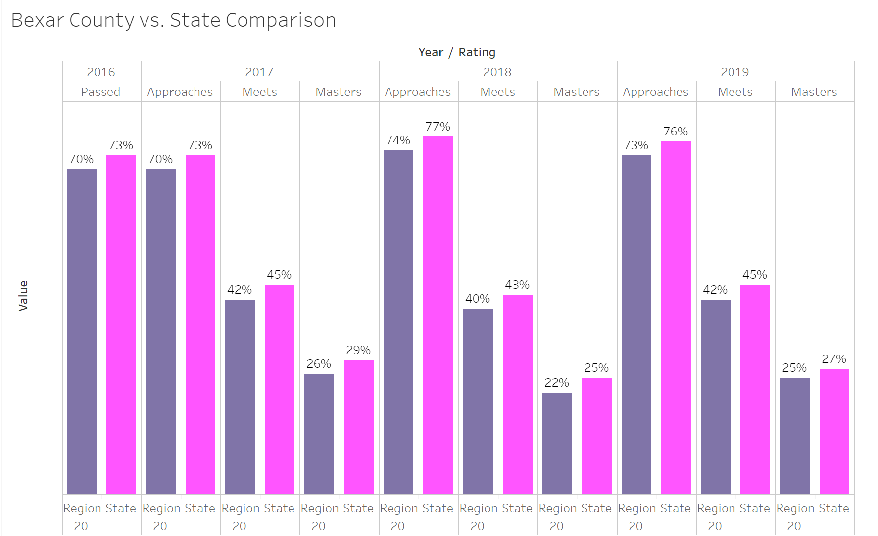
3rd grade Reading Data Bexar County Vs. State 2016 - 2019

Slide 9
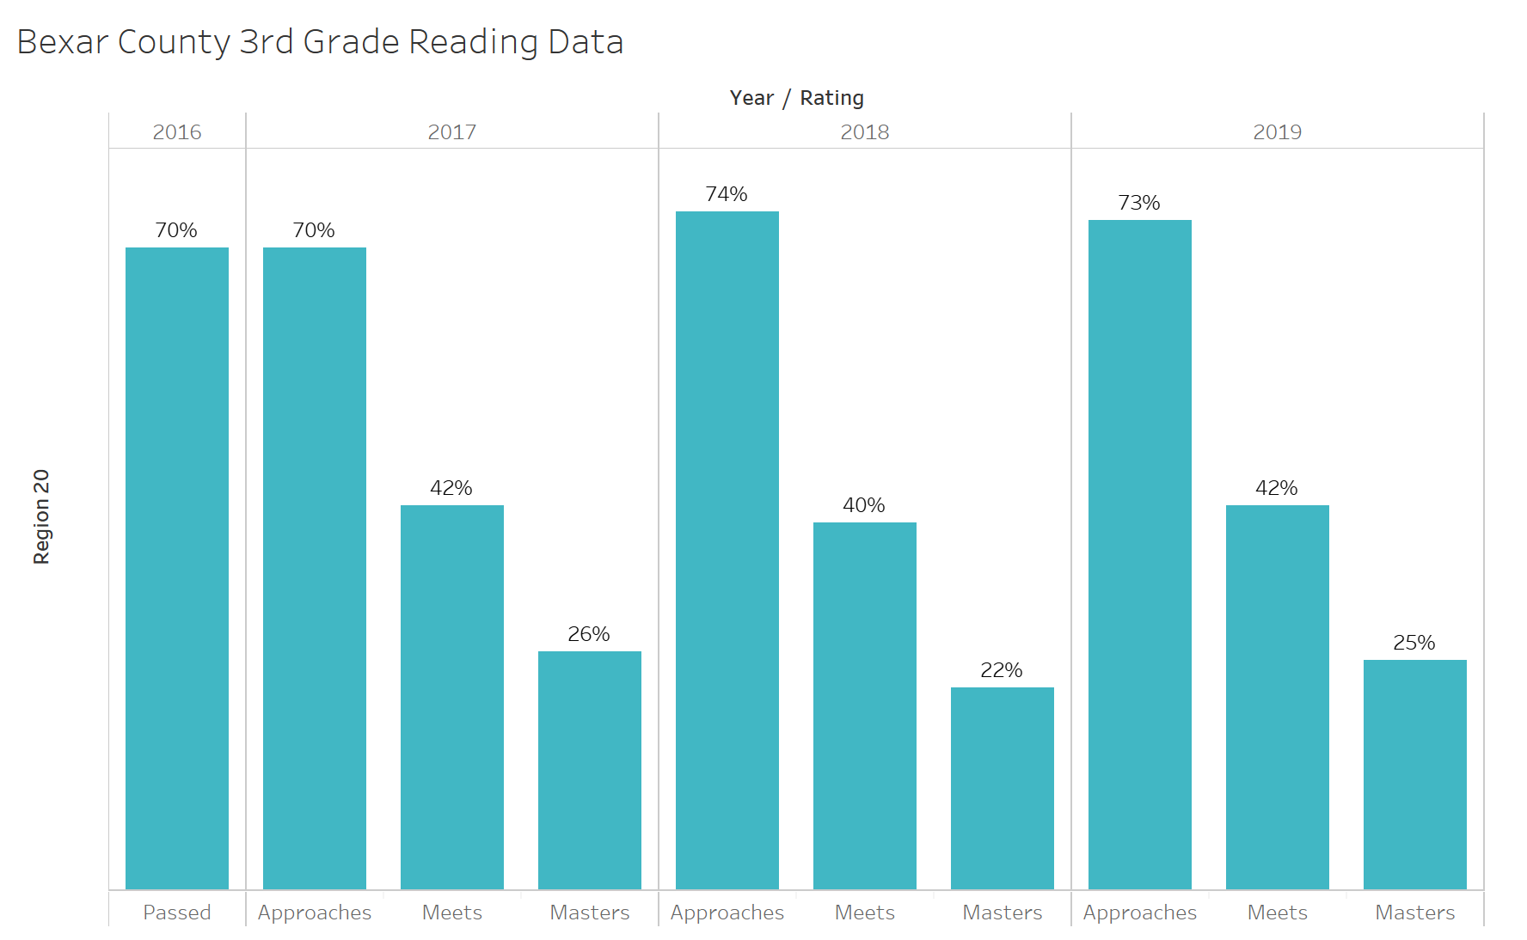
3rd grade reading Data Bexar County 2016 - 2019

Slide 10
STAAR 3rd Grade Reading
Test Data
Disparities of Various Ethnicities

Slide 11
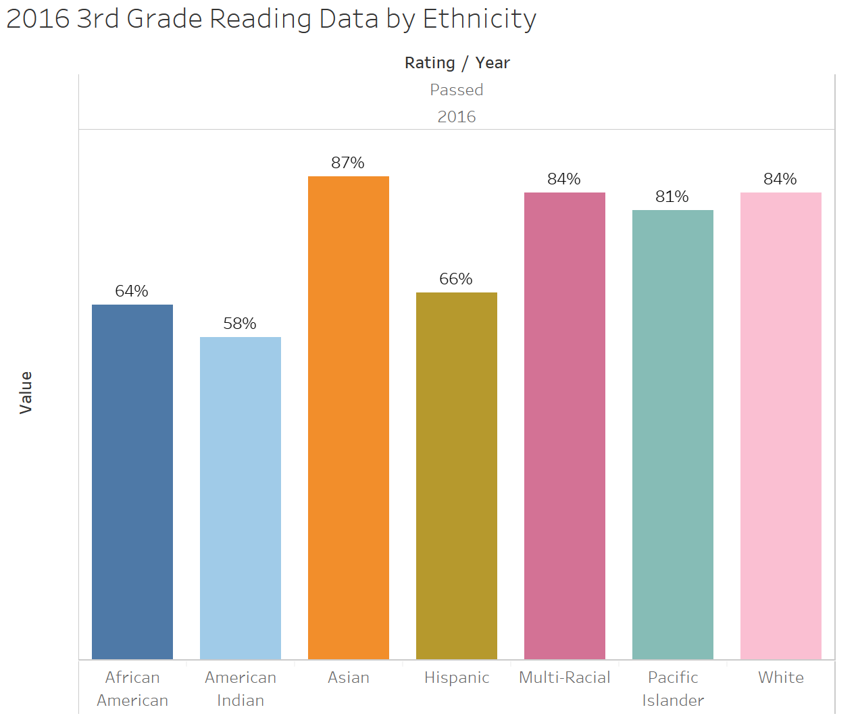
3rd grade Reading Data By Ethnicity 2016

Slide 12
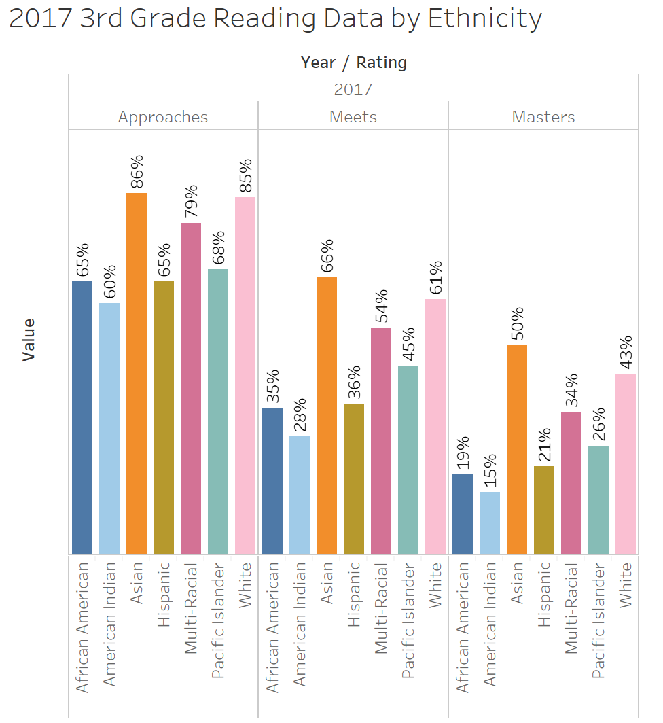
3rd grade Reading Data By Ethnicity 2017

Slide 13
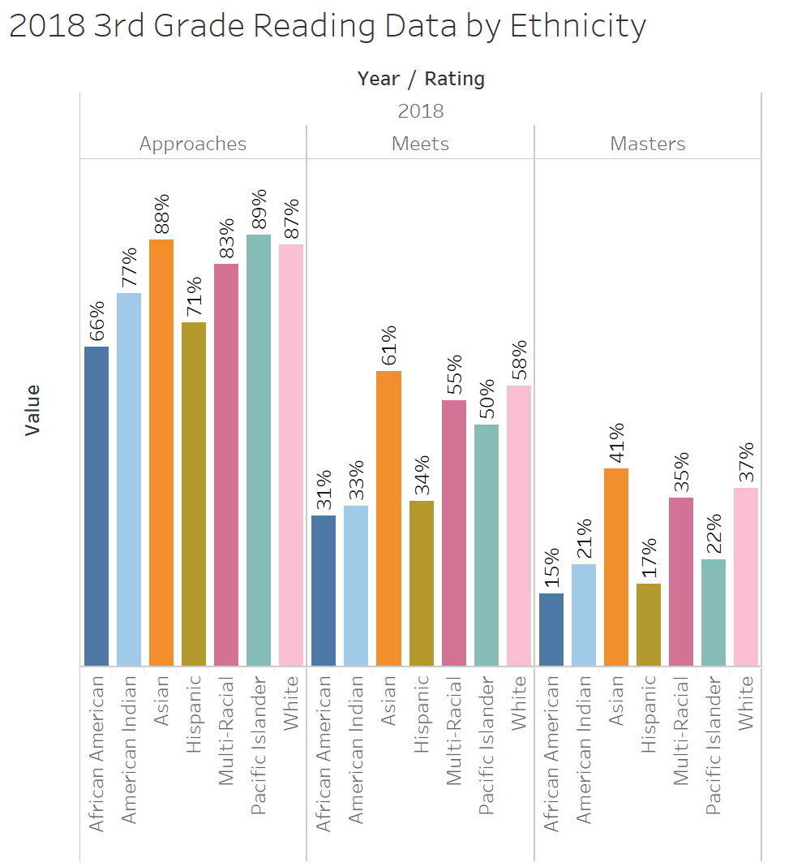
3rd grade Reading Data By Ethnicity 2018

Slide 14
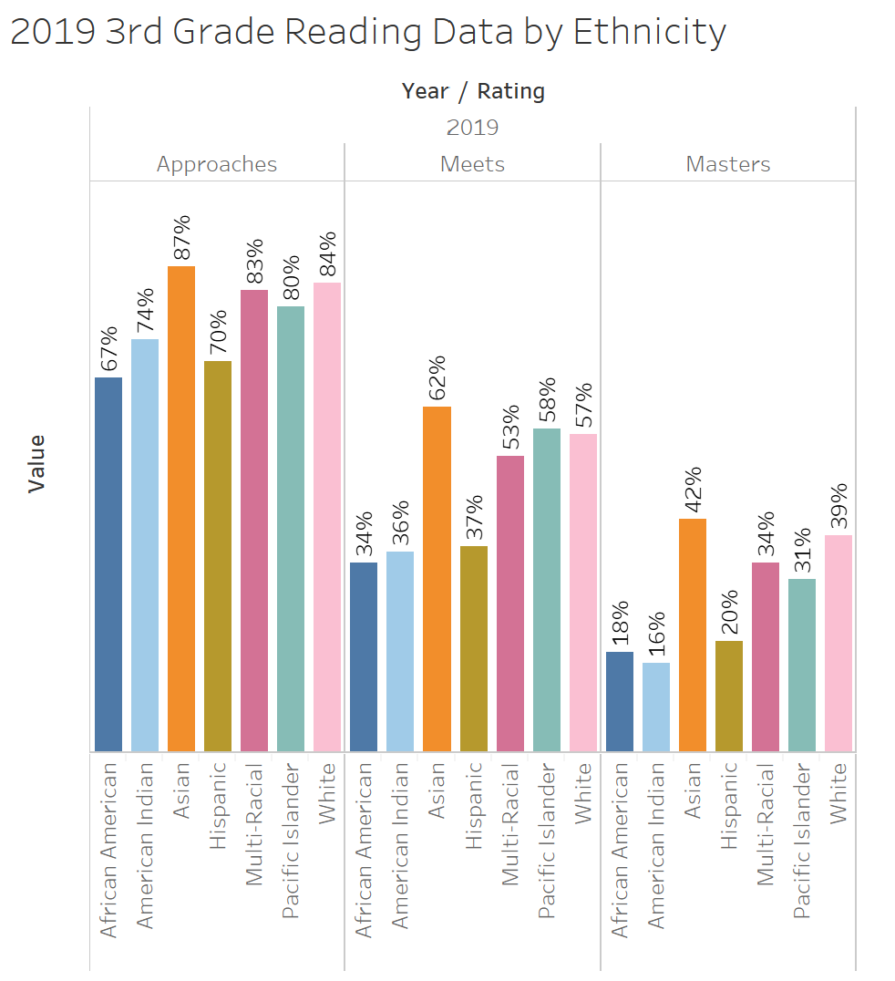
3rd grade Reading Data By Ethnicity 2019

Slide 15
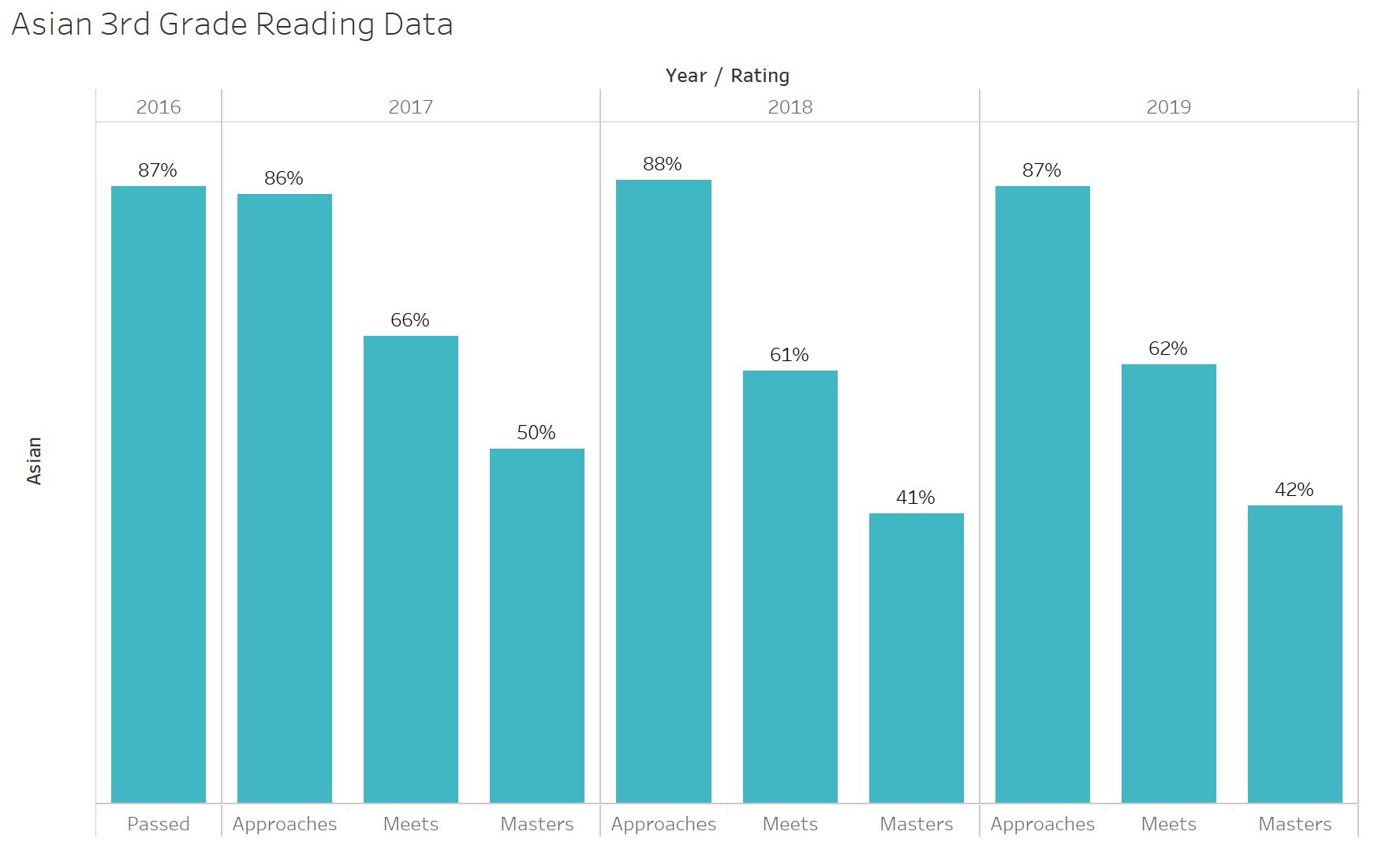
3rd grade Reading Data Asians 2016 - 2019

Slide 16
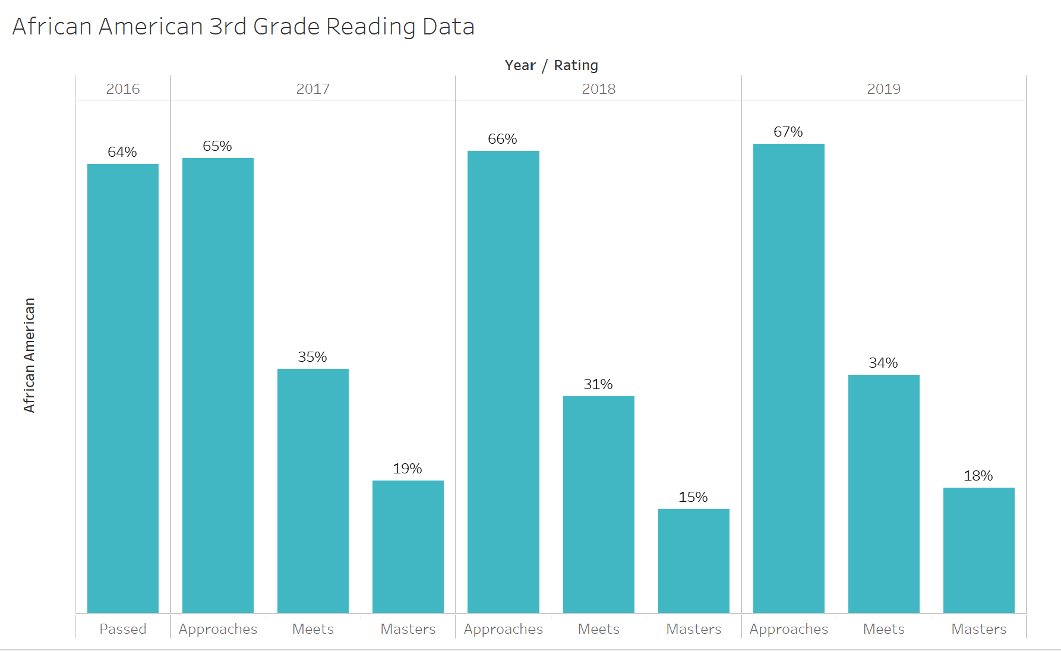
3rd grade Reading Data African Americans 2016 - 2019

Slide 17
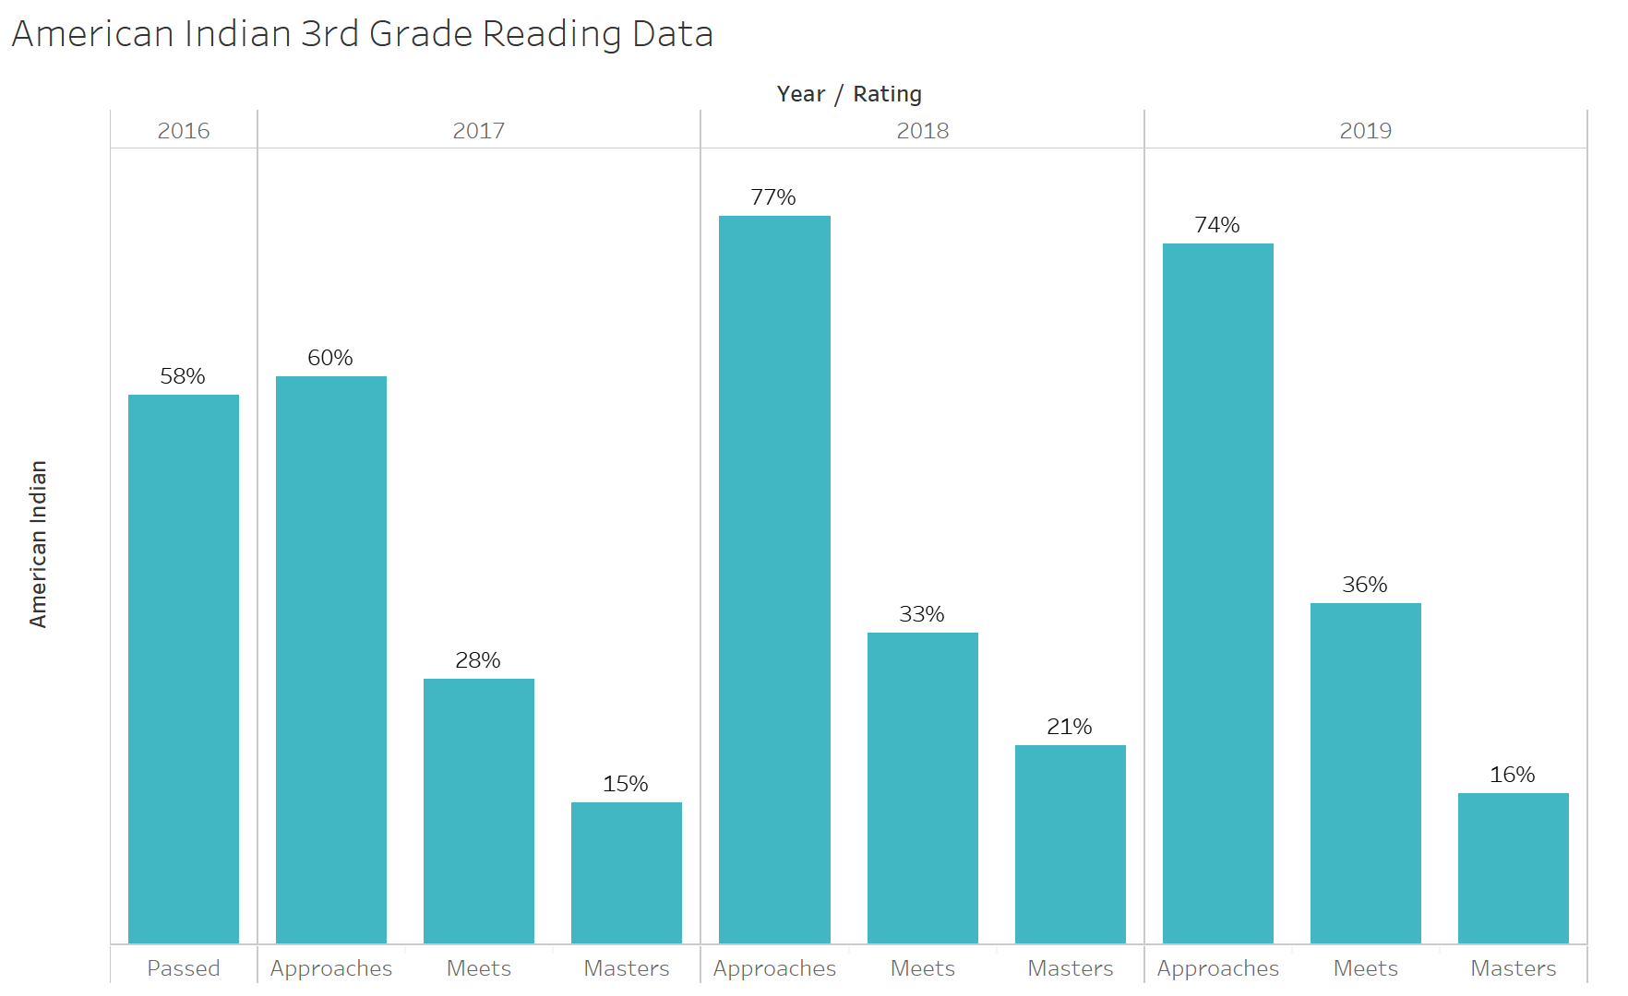
3rd grade Reading Data American Indians 2016 - 2019

Slide 18
STAAR 3rd Grade Reading
Test Data
Gender Disparities

Slide 19
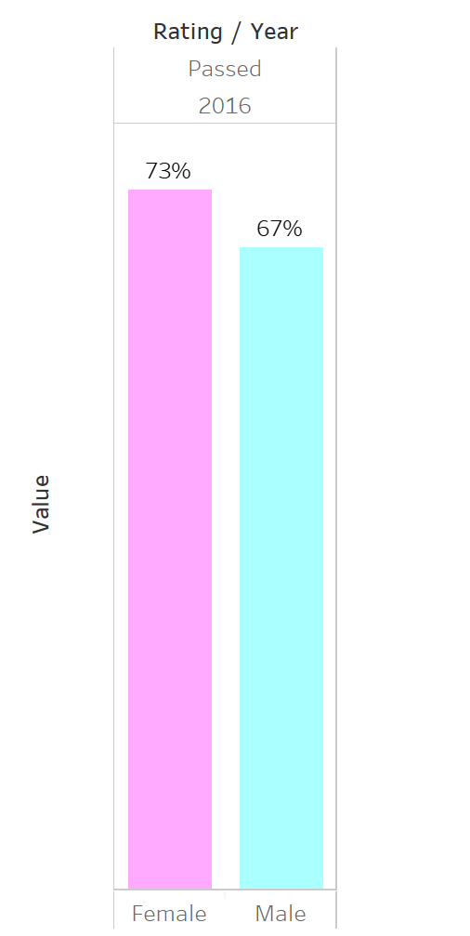
3rd grade Reading Data Females Vs. Males 2016

Slide 20
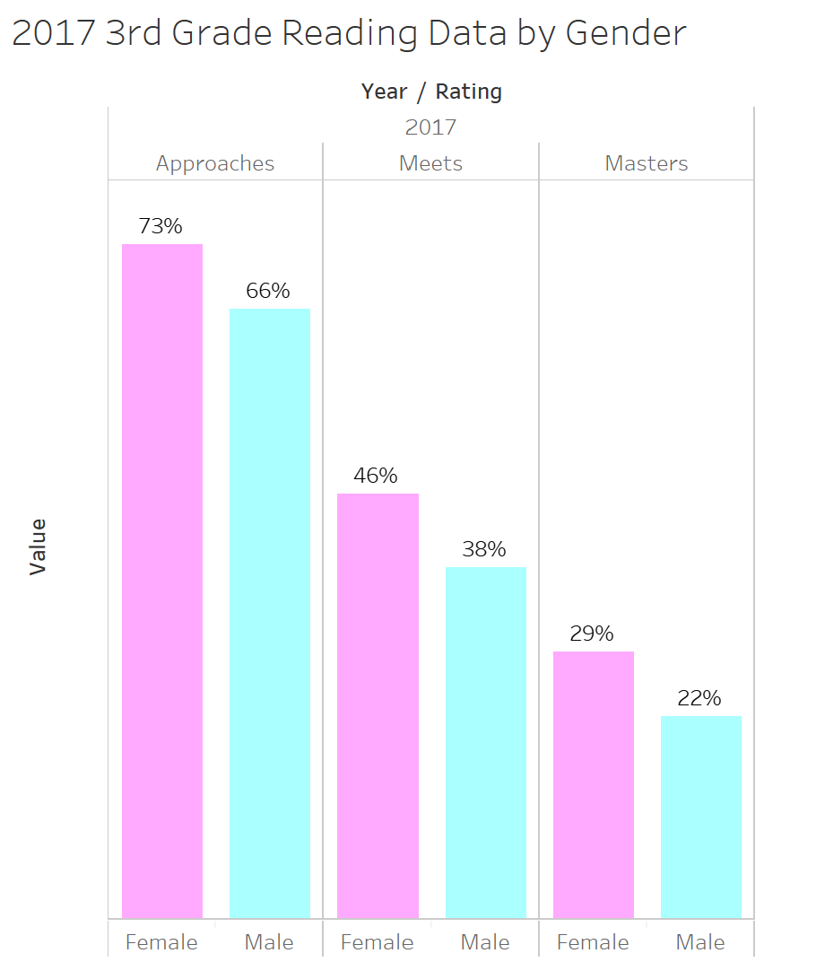
3rd grade Reading Data Females Vs. Males 2017

Slide 21
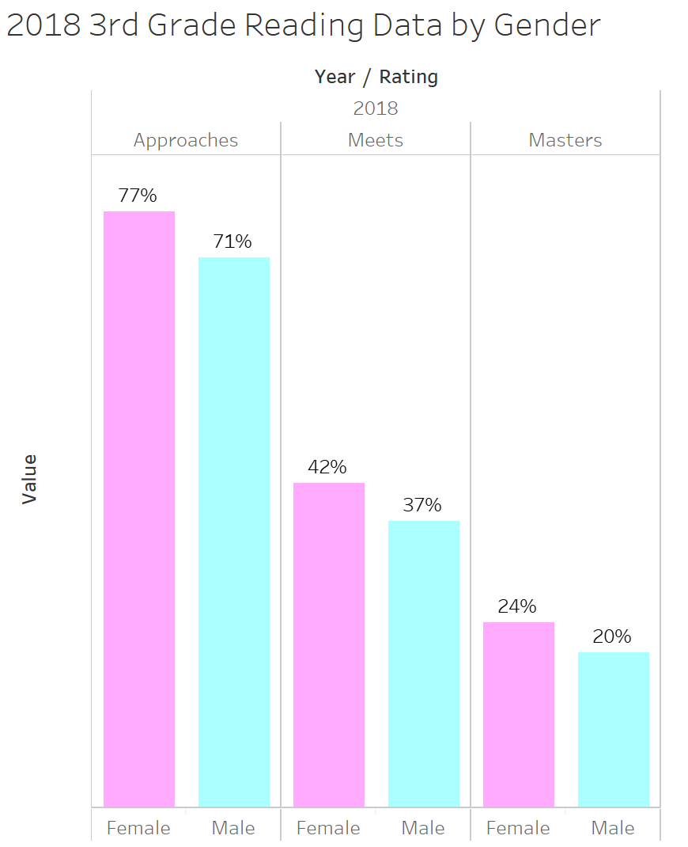
3rd grade Reading Data Females Vs. Males 2018

Slide 22
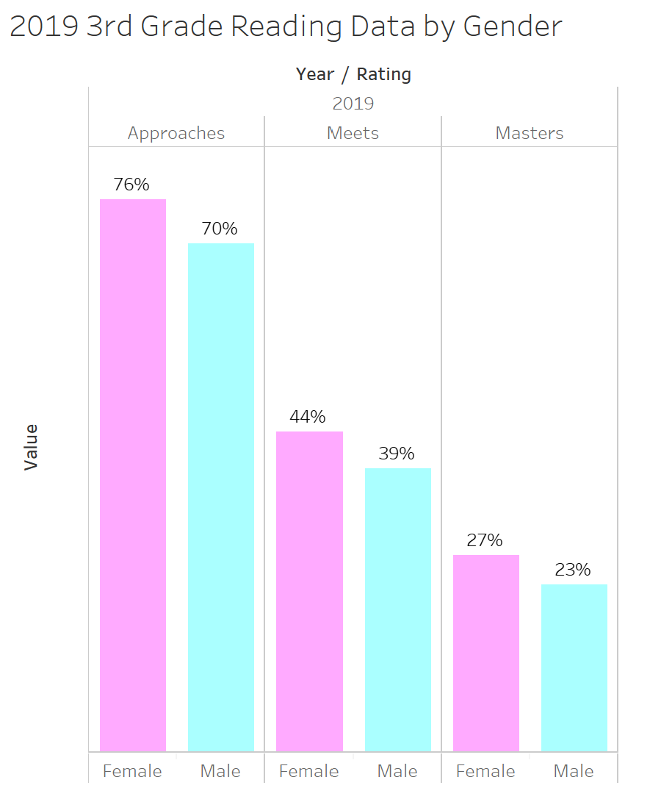
3rd grade Reading Data Females Vs. Males 2019

Slide 23
STAAR 3rd Grade Reading
Test Data
Disparities of Various Sub-Populations

Slide 24
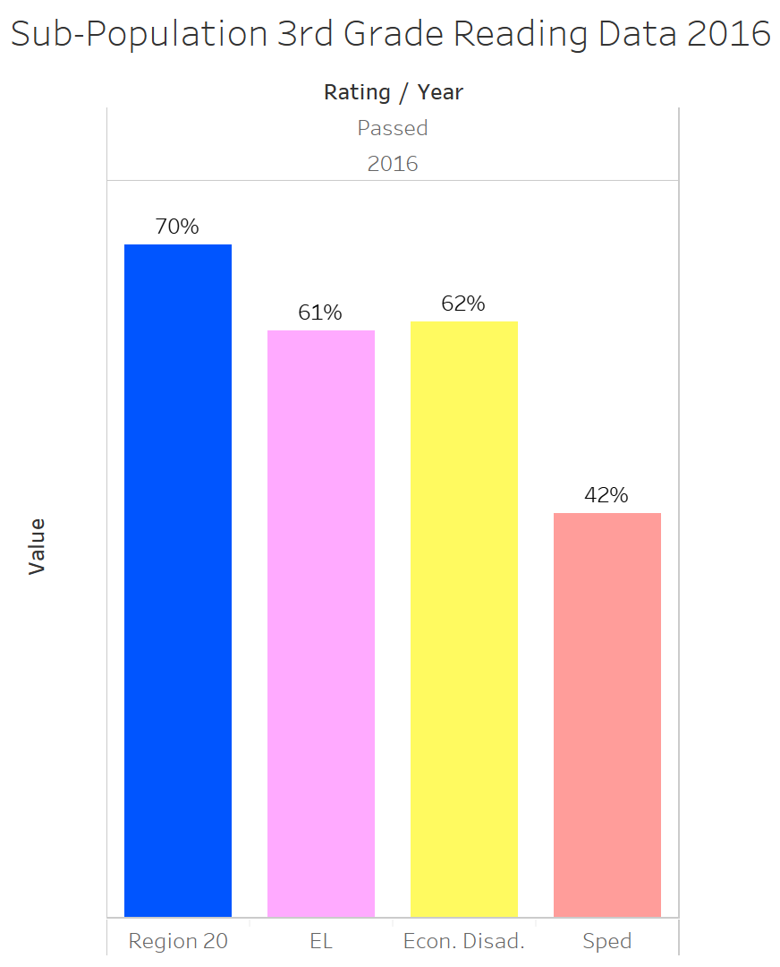
3rd grade Reading Data Sub-Population 2016

Slide 25
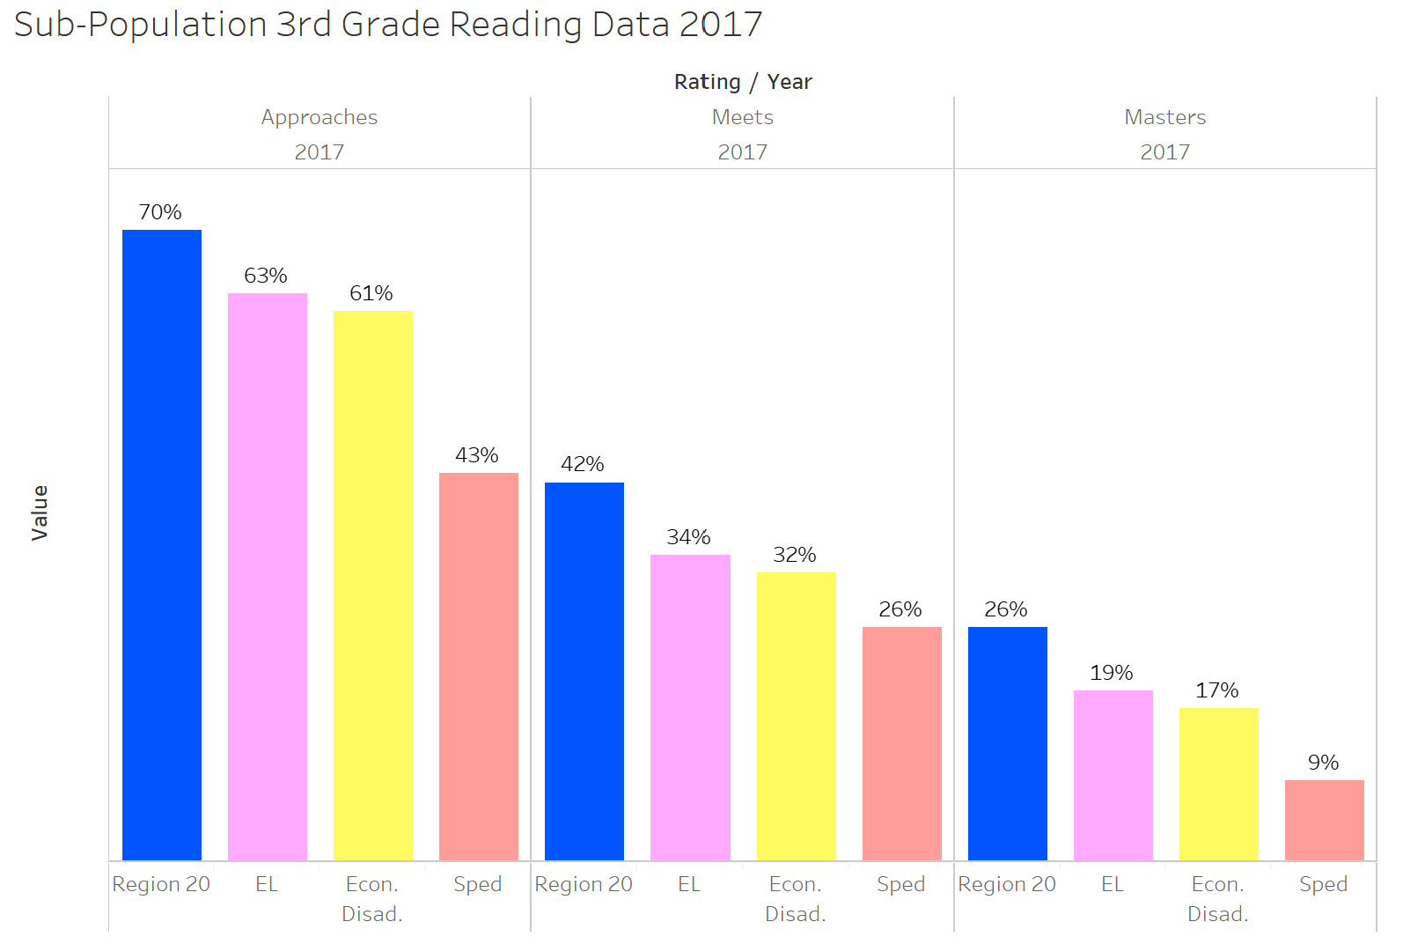
3rd grade Reading Data Sub-Population 2017

Slide 26
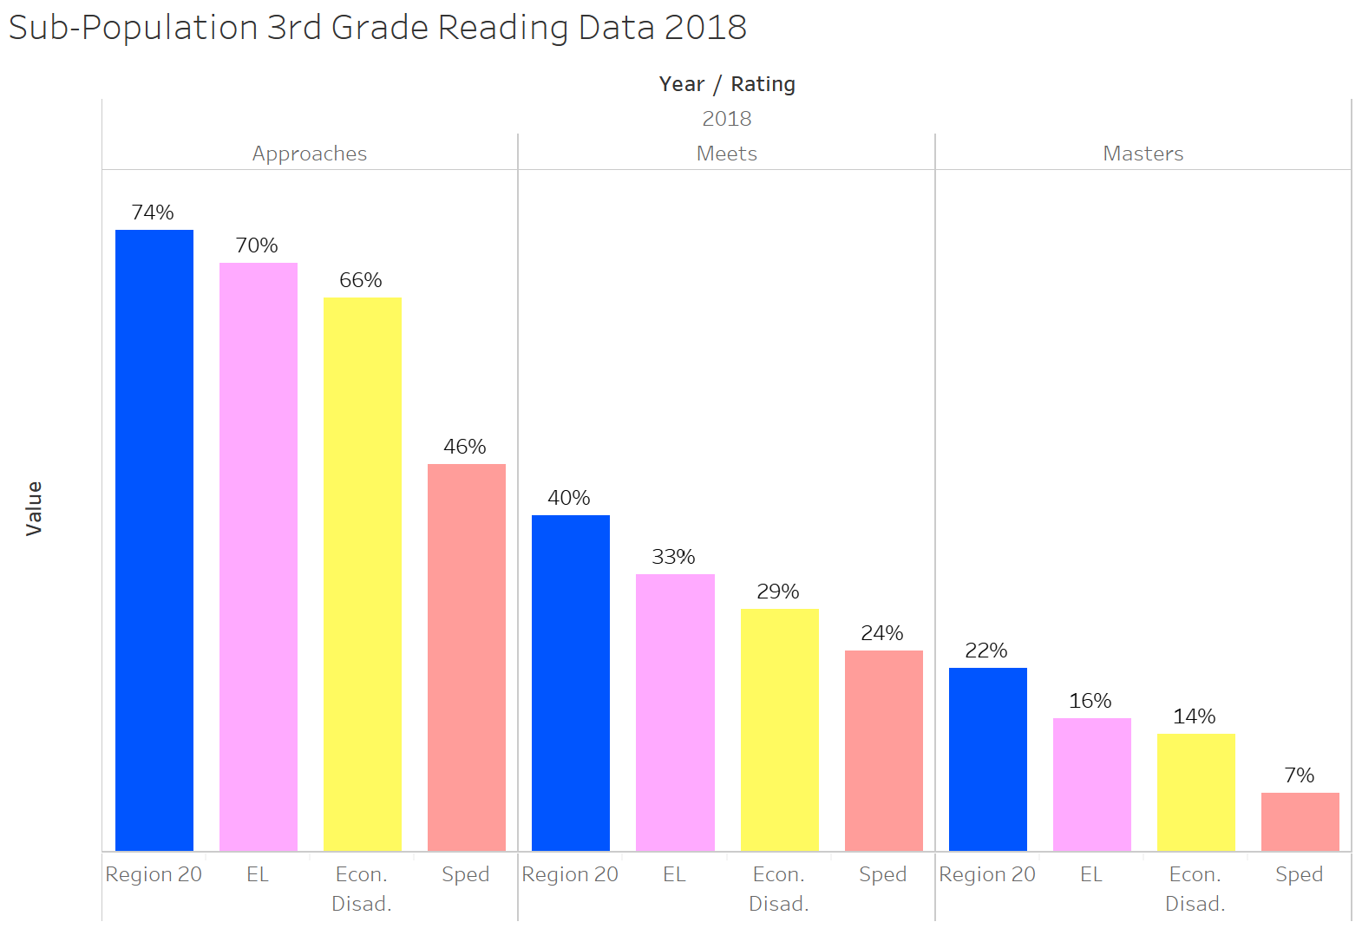
3rd grade Reading Data Sub-Population 2018

Slide 27
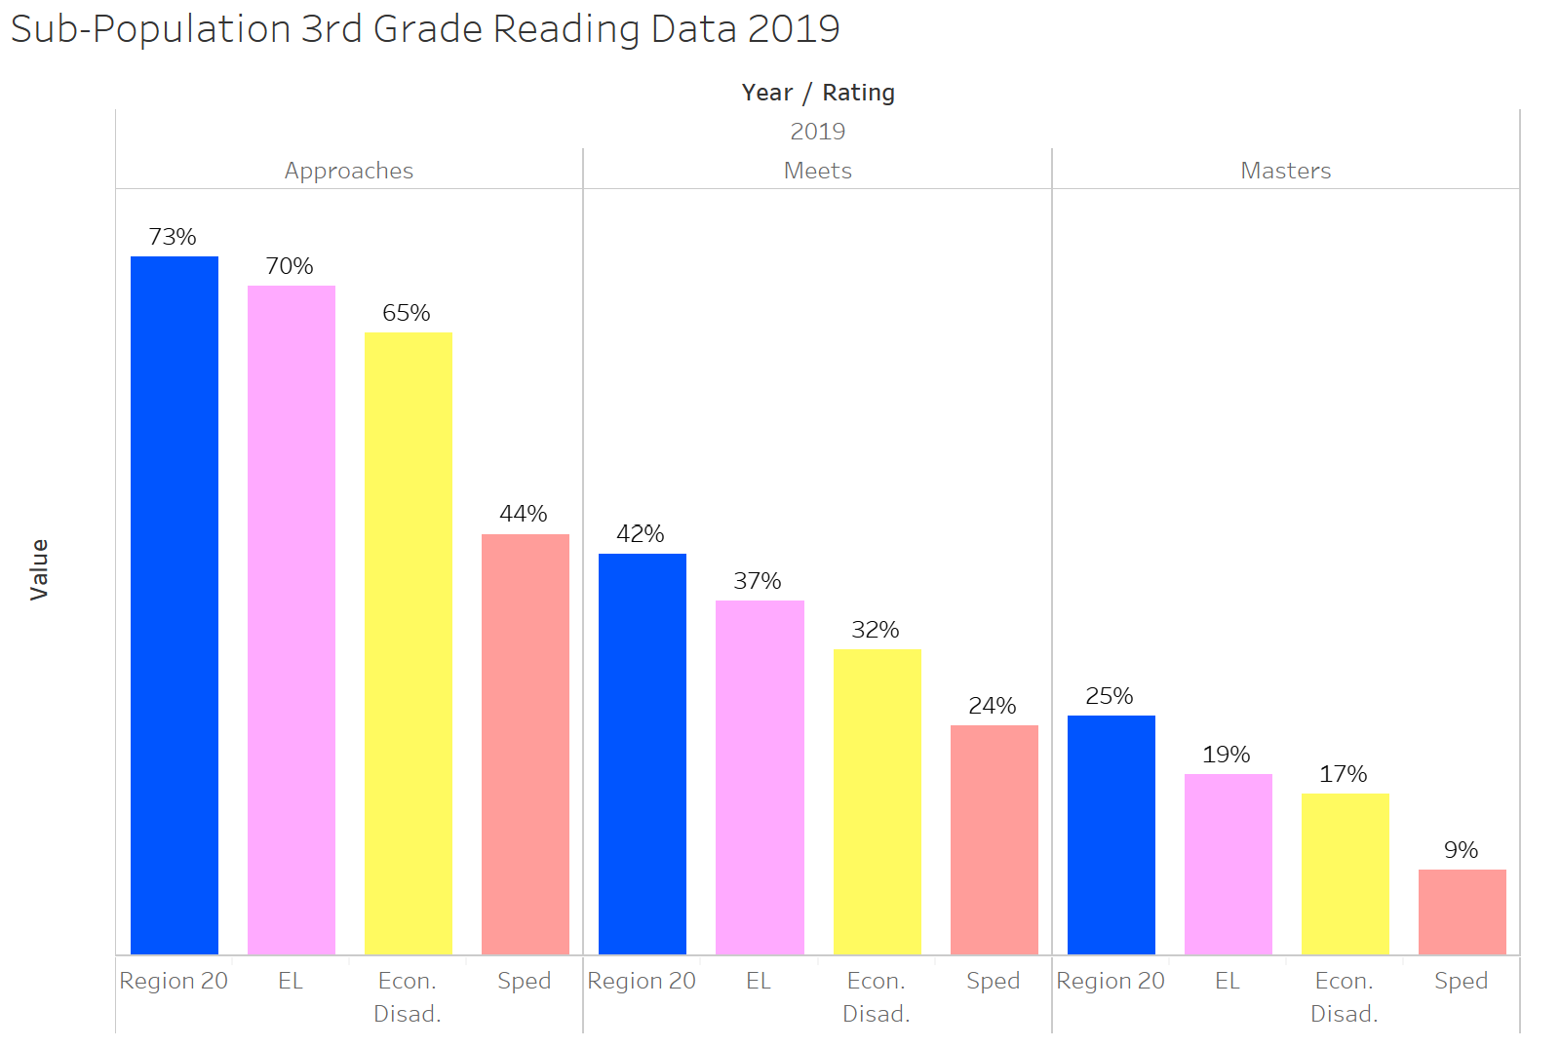
3rd grade Reading Data Sub-Population 2019

Slide 28
Summary
Overall, the 2016 – 2019 data shows that there is typically a -3% difference between Bexar County students and the rest of the state
There is an 8% disparity between the economically disadvantaged students and Bexar County overall
Asians are the highest scoring ethnicity in Bexar County for 2016 – 2019
African Americans showed improvement from 2016 - 2019 for approaches and masters
American Indians are the lowest scoring ethnicity in Bexar County for 2016 - 2019
Females outscored males in 2016 – 2019 by at least 4% per rating

Slide 29
Strategies to Improve Results Using Social emotional Learning
Establish trusting relationships with students (Be a mentor)
Listen to students & their needs/concerns
Find out what students are passionate about
Know your student’s strengths and weaknesses
Have a clear plan for Response to Intervention (RTI)
Track progress toward goals
Recognize and celebrate successes
Be clear with students
What are some ways that we can target American Indians, males and the sub-population group?

Slide 30
Conclusion
Even though data and scores are important, building relationships with students is the connection that can really make the difference in the lives and career outcomes of students
Social emotional learning can impact students in ways that will go far beyond academics
Social emotional learning can increase the likelihood that a student will:
Graduate high school
Have better mental health
Have more positive relationships
Decrease criminal behavior
Become positive contributing members of society

Slide 31
Thank You!

Slide 32
Credits and Cited Sources
Chiaki Konishi and Tracy K.Y. Wong, “Relationships and School Success: From a Social-Emotional Learning Perspective”, IntechOpen, September 19th 2018
https://www.intechopen.com/books/health-and-academic-achievement/relationships-and-school-success-from-a-social-emotional-learning-perspective
John Payton Roger P. Weissberg Joseph A. Durlak Allison B. Dymnicki Rebecca D. Taylor Kriston B. Schellinger Molly Pachan, “The Positive Impact of Social and Emotional Learning for Kindergarten to Eighth-Grade Students”, Collaborative for Academic, Social and Emotional Learning, December 2008,
https://www.casel.org/wp-content/uploads/2016/08/PDF-4-the-positive-impact-of-social-and-emotional-learning-for-kindergarten-to-eighth-grade-students-executive-summary.pdf
Giancarlo Brotto, “The Future of Education Depends on Social Emotional Learning: Here’s Why”, EdSurge, 2011,
https://www.edsurge.com/news/2018-06-04-the-future-of-education-depends-on-social-emotional-learning-here-s-why
Janelle Cox, “Teaching Strategies to Support Social Emotional Learning” K-12 Teachers Alliance,
https://www.teachhub.com/teaching-strategies-support-social-emotional-learning

